Slide 1
Task
r
Task and Schedule Manager
Franky Cen Kenan Millet Yatin Kaushal

Slide 2
Overview
Project Proposal
Requirements
Functional Requirements, Use Cases
Design
Deployment Architecture
Sequence Diagrams
Component Architecture
Implementation
Code & Design
Post Implementation Review

Slide 3
The Problem
The Problem
Poor time management, Prioritizing less urgent work
How It Affects You
Less free time, Stress, Lack of Sleep, Frustration
How It Affects Your Work
Work can be rushed, low quality, or late
Less work done overall
What You Need to Do
Balance your Activities
Stay ahead of your work
Use your time effectively
Notes:
It is difficult to manage your time when you have a large amount of work to do. It is not easy for us to efficiently arrange all of our events. We might give too much time to tasks that don’t need it. And this will impact both you and your work. You might be stressed when you find your work piling up, and the quality of your work will decline. You’ve got to find a way to effectively use your time.

Slide 4
The Solution: Taskr
Task and Schedule Manager
Tasks
Importance, Urgency, Duration, Desirability
Schedules
Generated for User
Weekly or Date-Specific
Taskr
Increase time efficiency
Increase work quality
For School, Business, and Personal environments
Notes:
We introduce: Taskr, the Task and Schedule Manager. Users provide information about their Tasks to Taskr. Users would rate Tasks based on importance, urgency, and desirability. Users can also provide a deadline for the urgency field. Taskr can generate a Schedule that will fit the User. The generated Schedule will be based on each Taskr field.

Slide 5
Requirements
Users must be able to:
Create, Modify, and Delete Tasks & Schedules
View the List of Tasks or Schedules
Modify System Options
The System must be able to:
Generate a Schedule based on the User’s needs
Adapt to User activity
Users are not forced to follow the Schedule
Notify the User about upcoming Tasks

Slide 6
Use Cases

Slide 7
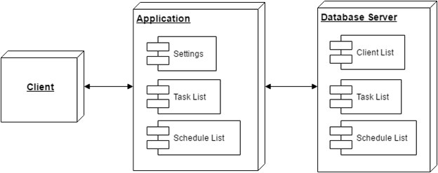
Deployment Architecture

Slide 8
Sequence Diagram
Typical Event:
A User make a request
The Server forwards the request
The Database handles the request
The Interface displays the result

Slide 9
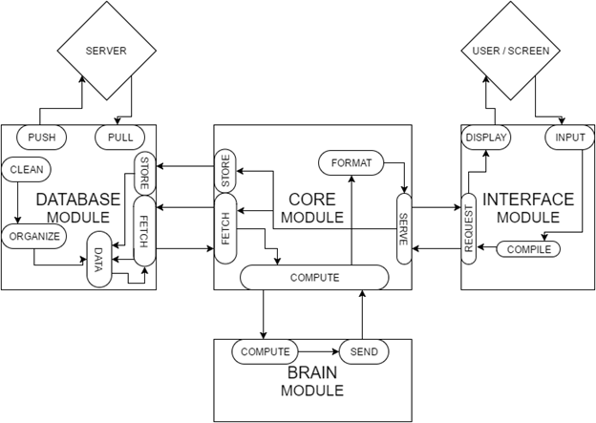
Component Architecture

Slide 10
Implementation - Input Requirements
Taskr runs on User input
Taskr needs to know which Tasks are fixed
Example: This class has a fixed timeslot of 11:00 AM - 12:20 PM.
Taskr needs to know the User’s preferences
Desired free time per day and (optionally) per week
Desired time range for sleep, eating, etc.
Like fixed tasks, but happen within time ranges
Grouping coefficient
Taskr needs to know how closely the User follows the Schedule
Users mark Tasks with a certain percentage of completion
Note: this option was not implemented in time for delivery

Slide 11
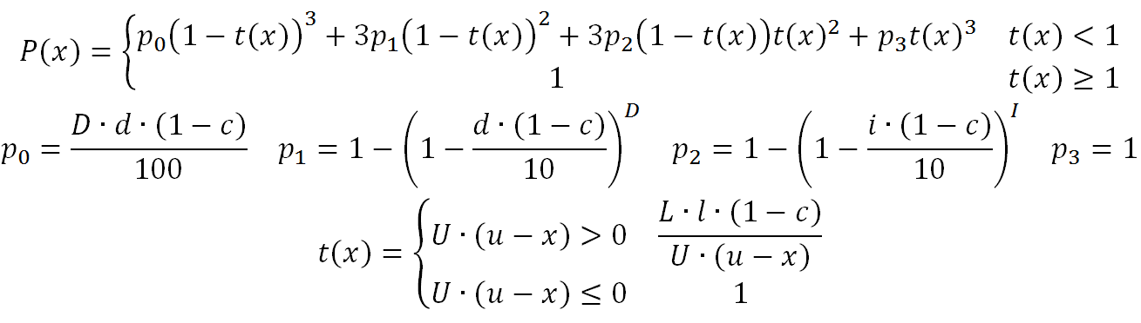
Implementation - Priority Calculation ^{[Graph]}
d = Desirability [1-10]
i = Importance [1-10]
u = Urgency [# hours]
l = length [# hours]
x = current time [# hours]
D = Desirability Weight [0-∞)
I = Importance Weight [0-∞)
U = Urgency Weight [0-∞)
L = length Weight [0-∞)
c = task completion [0-1)

Slide 12
Implementation - Schedule Generation
Splits up tasks into smaller pieces (default 1 hr)
Calculates priority of each individual piece
Places fixed tasks in schedule
Places pieces in schedule
A grouping variable determines how clustered pieces will be
Clusters of pieces will have 15-30 minute breaks between them, not including desired free time
Via a slider, the user may adjust grouping and piece size to better fit the schedule to their needs
Not yet implemented

Slide 13
Future Work
Add Server functionality
Have Schedule Generation be more interactive
Change schedules based on user activity
Adapt to how the user acts
Have more dimensions for learning from user
Custom Task Categories (e.g. Math HW, Essay, Documentation, etc.)
Allow Taskr to customize weights based on categories
Create Tasks and Schedules for other people
E.g. Employer to Employee, Parent to Child
Integrate Google Sign In
Allow Taskr to user Google Calendar events as fixed tasks
Allow Taskr to create calendar for user with generated schedule

Slide 14
Post-Implementation Review
What we did right
Documents completed
Addressed lack of competent solutions
Make our product unique
What we did wrong
Sub-par documentation
Difficult for new developers to follow
Under-estimated time budget
Very little documentation for schedule generation and priority calculation
What we would change
Additional weekly meetings
Manage time better
Be more realistic with deadlines for product deliverables

Slide 15
Conclusion - Why Taskr?
Problems
Stress, Low quality work, Less free time
Poor time management
Solution: Taskr
Have a schedule that matches your needs
Use time efficiently
Control your workflow

Slide 16
Questions / Answers

